Slide 1
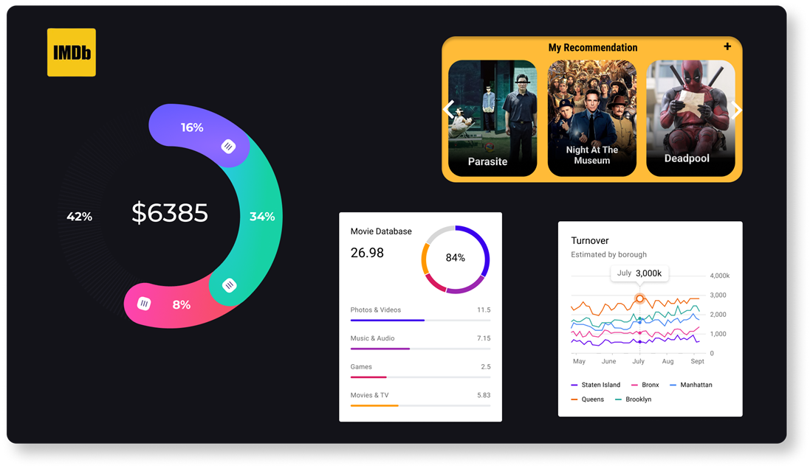
IMDB Movie Analysis
Final Project-1
By - Anindya Das

Slide 2
Description
Problem Statement: The provided dataset relates to IMDB movies, and our goal is to explore the question: “What factors influence a movie's success on IMDB?" In this context, we define success as achieving high IMDB ratings. Analyzing this issue is vital for movie producers, directors, and investors, as it will help them identify the elements that contribute to a movie's success, enabling them to make well-informed decisions for their future projects.

Slide 3
Approach
Data cleaning: this step involves preparing the data for analysis by addressing missing values, eliminating duplicates, converting data types if needed, and potentially performing feature engineering.
Data Analysis: In this section, analyze the data to understand the relationships between variables like genre, director, budget, year of release, and actors in relation to movie ratings.

Slide 4

Tech-Stack Used
The primary tech stack for this project will be excel, which provides a comprehensive range of functions for data analysis and manipulation. It is ideal for exploratory data analysis and insights generation. Key features like formulas, pivot tables, and charts will be used for data cleaning, calculating statistics, identifying trends, and visualizing hiring data, all through a user-friendly interface.
Microsoft Excel

Slide 5
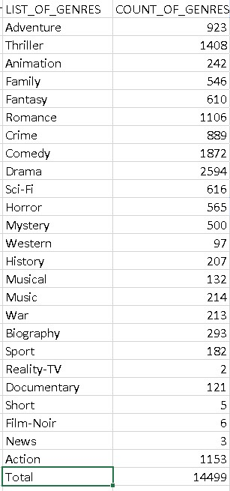
Data Analytics Tasks:
Movie Genre Analysis:
Analyze the distribution of movie genres and their impact on the IMDB score.
Task: Determine the most common genres of movies in the dataset. Then, for each genre, calculate descriptive statistics (mean, median, mode, range, variance, standard deviation) of the IMDB scores.

Slide 6
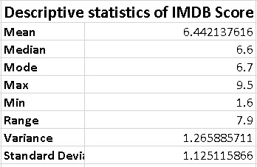
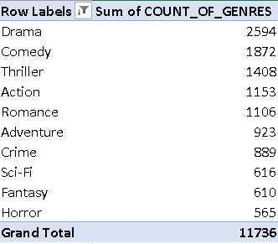
Descriptive statistics of IMDB Score
Top 10 Genres

Slide 7
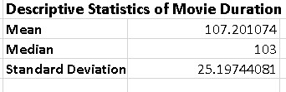
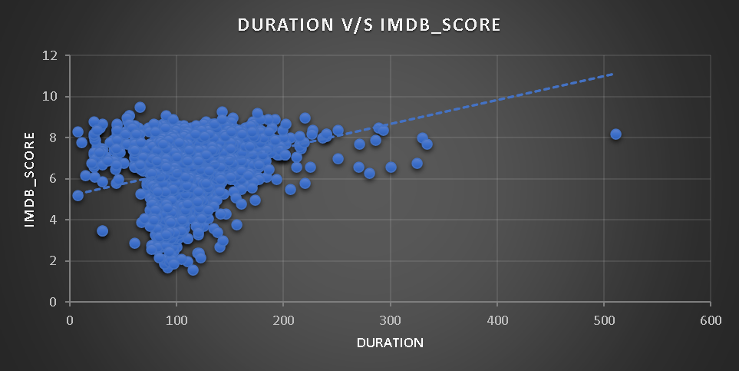
Movie Duration Analysis:
Analyze the distribution of movie durations and its impact on the IMDB score.
Task: Analyze the distribution of movie durations and identify the relationship between movie duration and IMDB score.

Slide 8
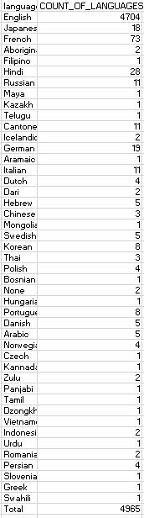
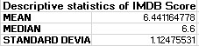
Language Analysis:
Situation: Examine the distribution of movies based on their language.
Task: Determine the most common languages used in movies and analyze their impact on the IMDB score using descriptive statistics.

Slide 9
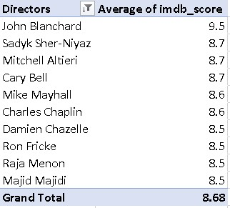
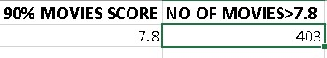
Director Analysis:
Influence of directors on movie ratings.
Task: Identify the top directors based on their average IMDB score and analyze their contribution to the success of movies using percentile calculations.

Slide 10
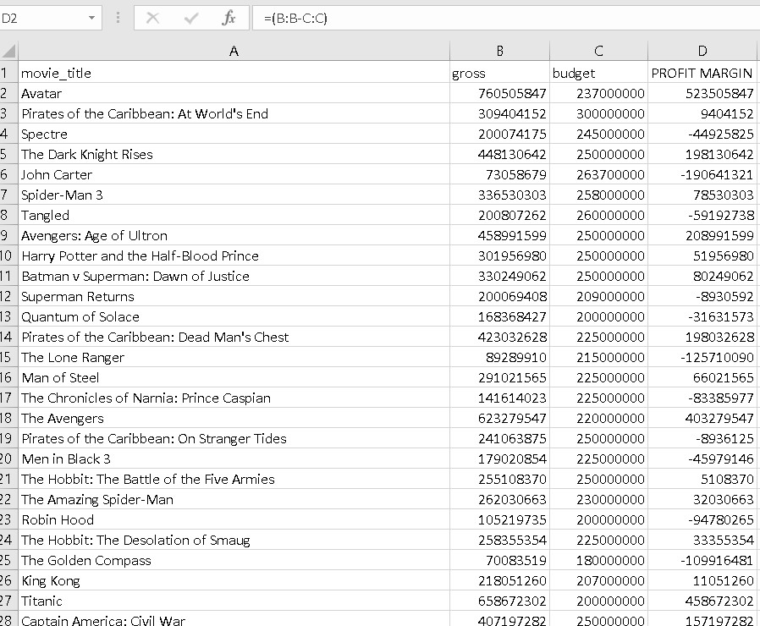
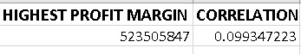
Budget Analysis:
Explore the relationship between movie budgets and their financial success.
Task: Analyze the correlation between movie budgets and gross earnings, and identify the movies with the highest profit margin.

Slide 11
Insights
The Most common movie genres from the dataset are Drama, Comedy, Thriller, and Action.
The average duration of a movie is 107 minutes.
The Most common languages used in the movies are English, French, Spanish, Mandarin, and German.
I have identified that John Blanchard, Sadyk Sher-Niyaz, Mitchell Altieri, Cary Bell, Mike Mayhall, Charles Chaplin, Damien Chazelle, Ron Fricke, Raja Menon, and Majid Majidi are the top 10 directors with average IMDb score >=8.5.
The Top with the highest profits are Avatar, Jurassic World, Titanic, Star Wars: Episode IV – A New Hope, and E.T. The Extra-Terrestrial. The Correlation between budget and gross is positive.

Slide 12
Conclusion
Dataset with Analysis:
https://docs.google.com/spreadsheets/d/1ORPF144yoAaxHSUefqpj5ZPB0h-lit2F/edit?usp=drive_link&ouid=100865564169059724511&rtpof=true&sd=true

Slide 13
Thank you!

